Slide 1





2D Graphics Rendering in Xamarin.Forms with SkiaSharp
- Udara Alwis -

Slide 2
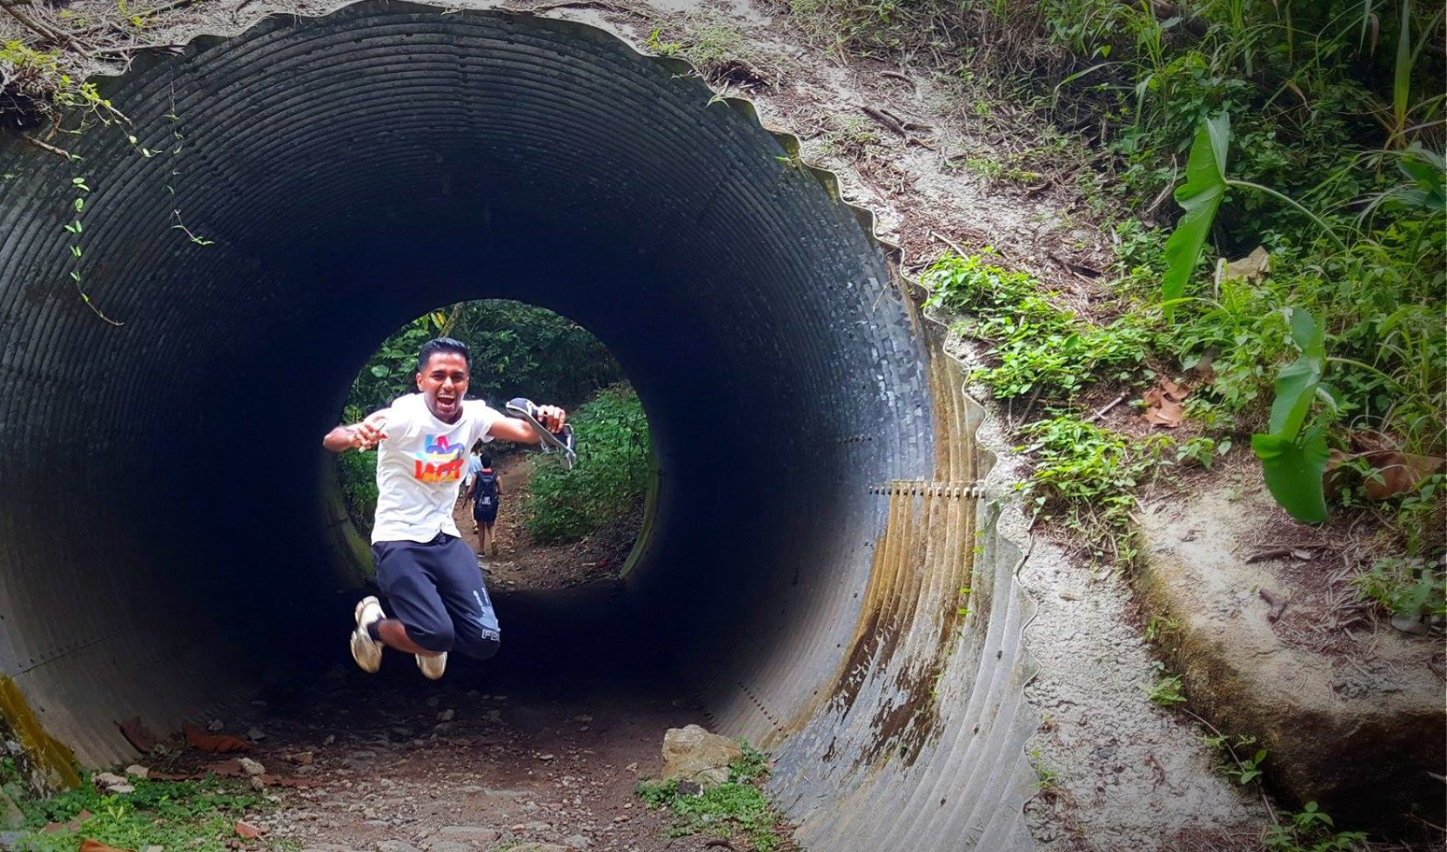
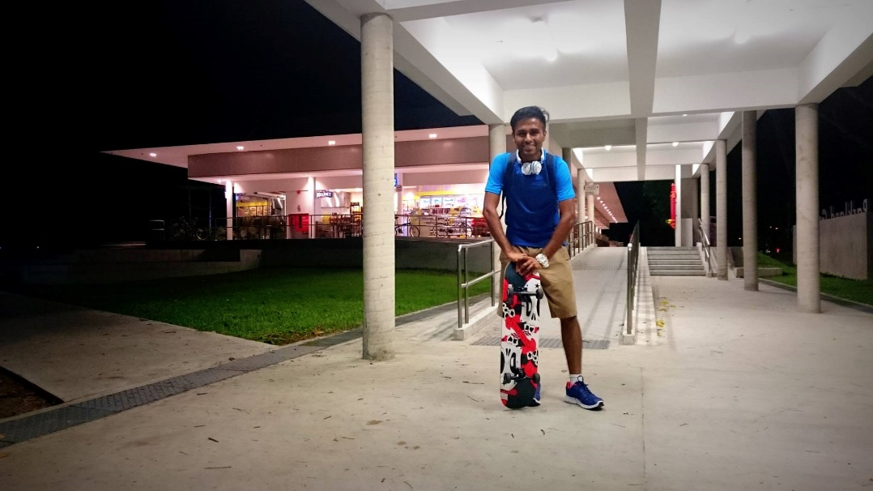
I am Udara Alwis
Xamarin Developer / Enthusiast
Mad Love for Mobile Development / UX
Microsoft Dot Net FTW!
25 Years of Awesomeness… ☺
Nature, Adventures, Running, Skateboarding, Cycling, Parkour
Xamarin Tech Blogger!
linkedin.com/in/UdaraAlwis
Notes:
My name is Udara Alwis. I’m a Xamarin Developer here in Singapore, and guilty as charged I’m a crazy Xamarin enthusiast.
I’ve got some mad love for Mobile Development and Mobile User Experience Engineering
Of course I’m a Microsoft fan boy. There goes by saying I’m still 24 years old.
When I’m not coding, I go on adventures, running, cycling, skateboarding.. All that fun stuff!

Slide 3
The journey we shall take…
- Graphics in Mobile Applications
2D Graphics?
2D Graphics Rendering in Xamarin.Forms?
SkiaSharp project intro
SkiaSharp basics…
SkiaSharp 2D Graphics Programming
User Interactions
Bitmap Image handling
Animations Rendering

Slide 4

Graphics in Mobile Applications
- Apps built with just default Buttons, Labels, Layouts… could become boring!
- Graphics are important!
- Interactive and Delightful user experience!
- Super fun to play around as a Developer! (conditional. lol)

Slide 5

2D Graphics?
2D computer graphics - the generation of two-dimensional visual elements…
2D Geometric shapes, Text, Images, 2D Transformations and Animations!

Slide 6
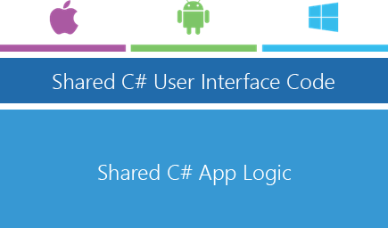
2D Graphics in Xamarin.Forms?
Xamarin.Forms – True cross-platform abstraction layer of Xamarin Native…
Basic Animations built in…
Not ideal nor direct support for advanced animations/graphics!

Slide 7



2D Graphics in Xamarin.Forms?
- CocosSharp (2D – 2D games)
- SkiaSharp (2D – graphics rendering)
- UrhoSharp (3D – pure 3D gaming engine)

Slide 8



behold, SkiaSharp
- Origins: Project Skia / Google Open Sourced / C++
- Immediate mode 2D vector graphics system
2D graphics, bitmaps, and text
A lot of cool stuff!
C# and DotNet wrapper of Skia: SkiaSharp
Github.com/mono/SkiaSharp

Slide 9
SkiaSharp basics…
SKCanvasView, derives from Xamarin.Forms.View
PaintSurfaceEvent, executes all the 2D drawing functionality
InvalidateSurface() for repainting
Draw Bitmap or SVGs

Slide 10
SkiaSharp basics…
SKCanvasView, hosts the paint surface
SKCanvas, the drawing surface that perform the actual drawing

Slide 11
SkiaSharp basics…
Demo
Install SkiaSharp
Add SKCanvasView
PaintSurface Event Handling
Initialize SKCanvas

Slide 12



SkiaSharp 2D Graphics Programming
Just a thought…
Mathematics is the base for any kind of Graphics Rendering!
Anything that you can think of Geometrically on a 2D plane, you can do it with SkiaSharp!

Slide 13
SkiaSharp 2D Graphics Programming
Transform operations such as Translate, Scale, Rotate, Skew
SKPaint object to specify color and other drawing attributes. Lightweight!
Style (Stroke / Fill / StrokeAndFill)
Color
StrokeWidth
IsAntialias, etc…

Slide 14
SkiaSharp 2D Graphics Programming
Drawing methods, DrawCircle() DrawRect() DrawLine() DrawText() DrawArc()… etc.
SKPath, is all you need to draw any kind of of 2D Shape!
A collection of contours, or outlines
Has methods, MoveTo(), LineTo(), ArcTo(), CubicTo()… etc.

Slide 15
SkiaSharp 2D Graphics Programming
Demo
Canvas Width / Height
SKPaint Objects
Drawing Circle / Stroke Line / Eclipse / Arc / Text
Translations and Scaling

Slide 16
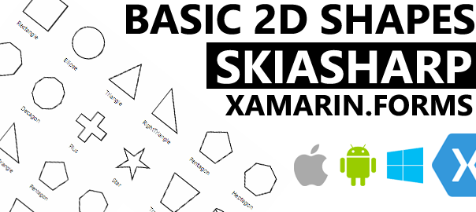
SkiaSharp 2D Graphics Programming
Beginners intro to 2D Shapes with SkiaSharp
theconfuzedsourcecode.wordpress.com/tag/skiasharp/

Slide 17

SkiaSharp 2D Graphics Programming
User Interactions
SKCavnasView touch handling event
Prefer to use a secondary touch handler
handle touch operations and push updates back to SKCanvas on demand

Slide 18
SkiaSharp 2D Graphics Programming
Demo
User Interactions

Slide 19

SkiaSharp 2D Graphics Programming
Bitmap Image handling
Loading images as Embedded resources
Decode to SKBitmap for drawing & manipulation
DrawBitmap() method
ImageFilers, built-in, oh yeah!

Slide 20
SkiaSharp 2D Graphics Programming
Demo
Bitmap Image Handling

Slide 21

SkiaSharp 2D Graphics Programming
Animations Rendering
Not so straight forward!
Handle manually.
Draw every single frame manually.

Slide 22
SkiaSharp 2D Graphics Programming
Demo
Animations Rendering

Slide 23
SkiaSharp 2D Graphics Programming
More awesome stuff at,
Xamarin official docs: developer.xamarin.com/skiasharp/
Github official samples repo: SkiaSharpFormsDemos

Slide 24
SkiaSharp 2D Graphics Programming
More awesome stuff at,
https://theconfuzedsourcecode.wordpress.com
Or my Github repo:
https://github.com/UdaraAlwis/
/SkiaSharp-Playground /XFSkiaSharpDemo /SkiaSharpAtomStructure

Slide 25

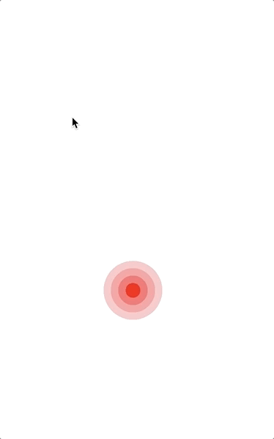

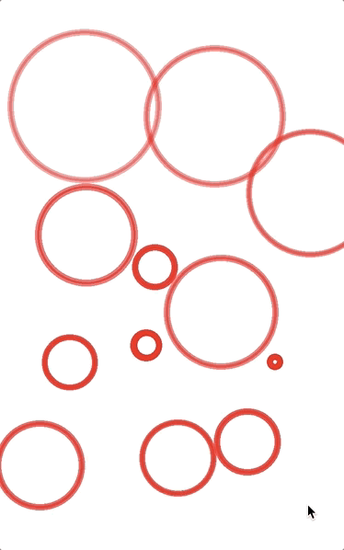
Udara’s SkiaSharp Adventures…
https://github.com/UdaraAlwis/SkiaSharp-Playground

Slide 26

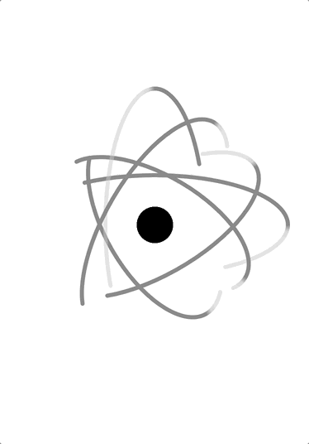
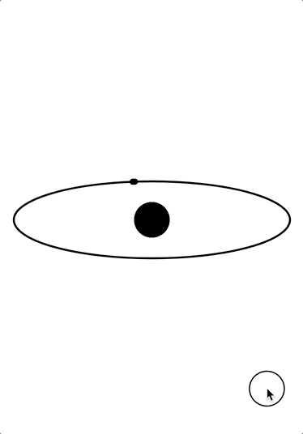
Udara’s SkiaSharp Adventures…

Slide 27


Udara’s SkiaSharp Adventures…

Slide 28




…well that’s it!
Now go build something cool with awesome Xamarin with SkiaSharp!
Good luck and enjoy!

Slide 29


Thank You!
For Weekly Xamarin Articles check out my blog, https://theconfuzedsourcecode.wordpress.com
Udara Alwis
CODENAME: [ÇøŋfuzëÐ SøurcëÇødë]

